Slide 1
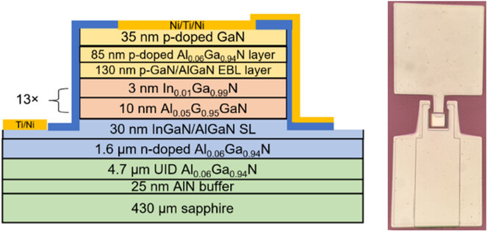
Demonstration of Near‐Size‐Independent External Quantum Efficiency for 368 nm UV Micro‐LEDs
Physica Rapid Research Ltrs, First published: 23 May 2024, DOI: (10.1002/pssr.202400119)
Notes:
Cross‐sectional schematic of UV‐A LED with optical microscope image.
IF THIS IMAGE HAS BEEN PROVIDED BY OR IS OWNED BY A THIRD PARTY, AS INDICATED IN THE CAPTION LINE, THEN FURTHER PERMISSION MAY BE NEEDED BEFORE ANY FURTHER USE. PLEASE CONTACT WILEY'S PERMISSIONS DEPARTMENT ON PERMISSIONS@WILEY.COM OR USE THE RIGHTSLINK SERVICE BY CLICKING ON THE 'REQUEST PERMISSIONS' LINK ACCOMPANYING THIS ARTICLE. WILEY OR AUTHOR OWNED IMAGES MAY BE USED FOR NON-COMMERCIAL PURPOSES, SUBJECT TO PROPER CITATION OF THE ARTICLE, AUTHOR, AND PUBLISHER.

